Slide 1
Privacy By Design: Differential Privacy For Secure Machine Learning

Slide 2
Outline
Motivation For Privacy-Preserving ML
Data Privacy Problem
Plausible Deniability (Randomized Response)
Differential Privacy
Mechanisms for Achieving Differential Privacy
Applications and Challenges
Conclusion and Q&A

Slide 3
With Great Data, Comes Great Responsibility!
The exponential growth of machine learning (ML) hinges on data, but its acquisition often raises privacy concerns due to the potential exposure of sensitive information.
Thus, the challenge lies in balancing the potential benefits of machine learning with the risks of compromising user privacy.

Slide 4
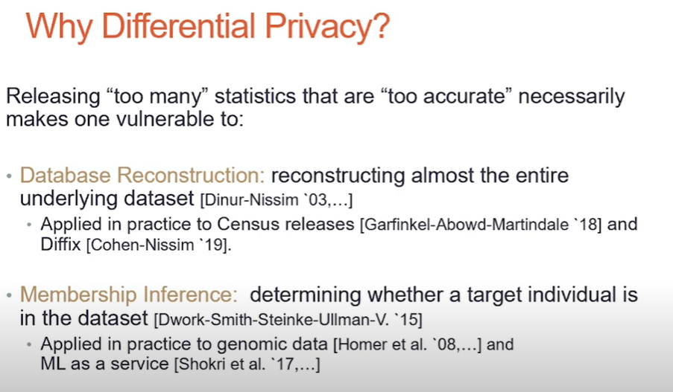
Motivation

Slide 5
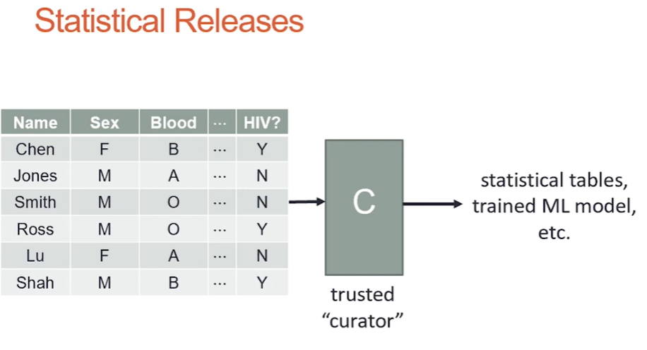

Slide 6
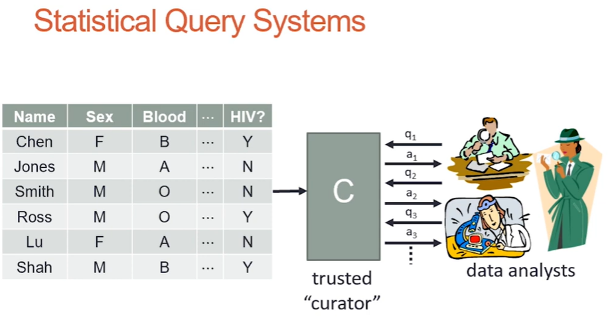

Slide 7
Data Privacy Problem

Slide 8
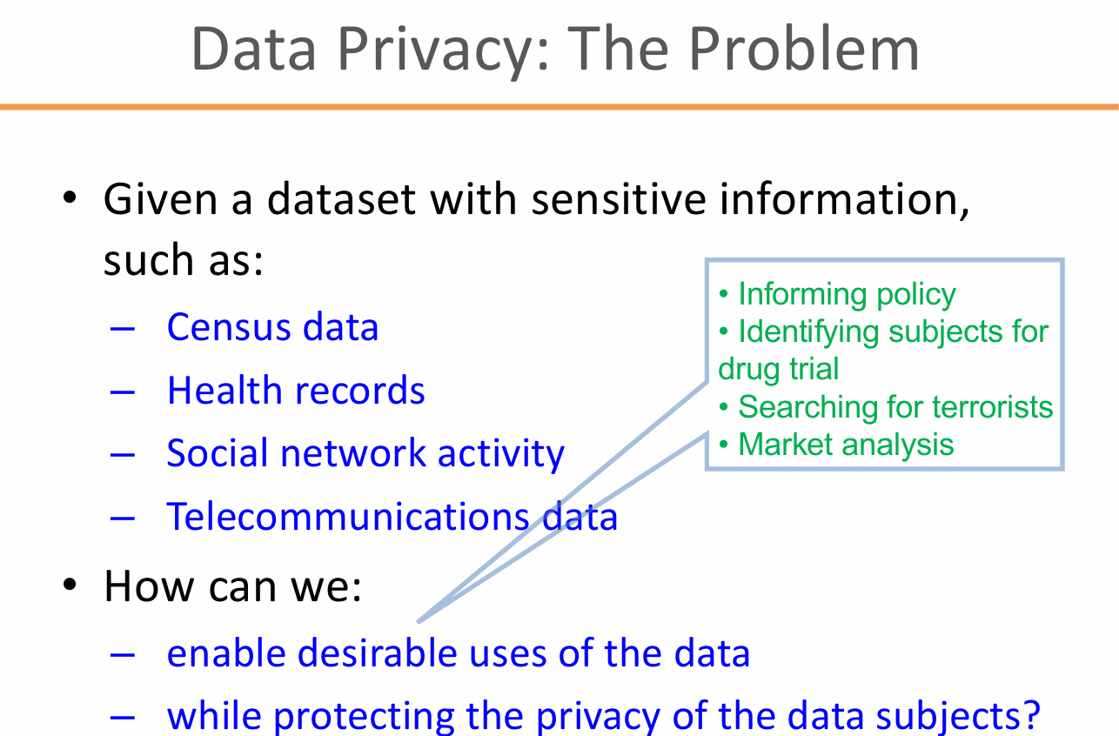

Slide 9
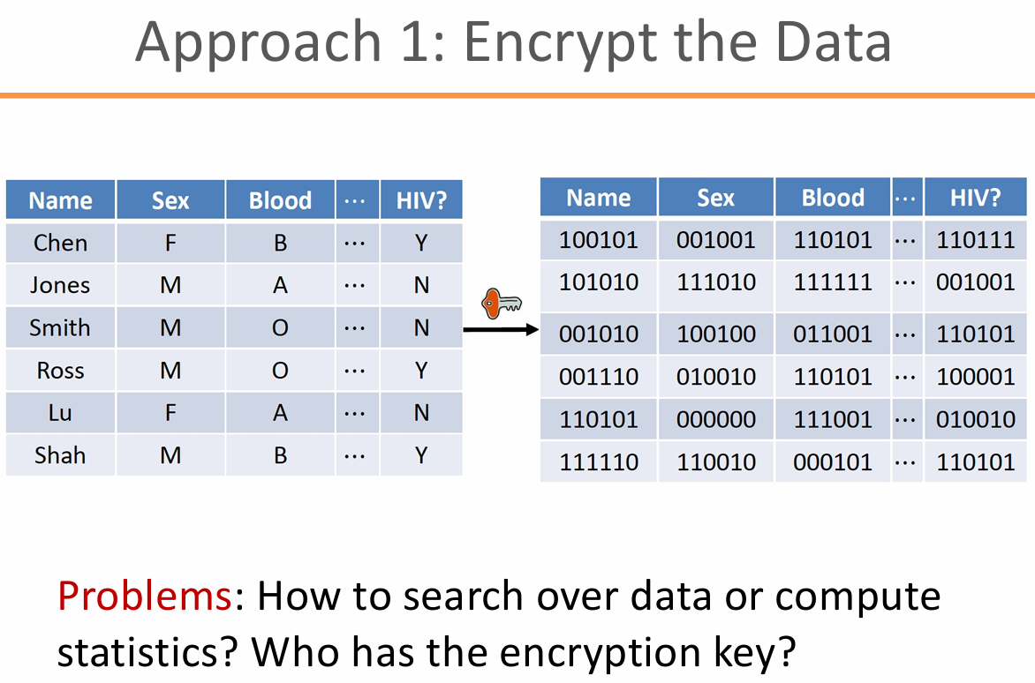

Slide 10
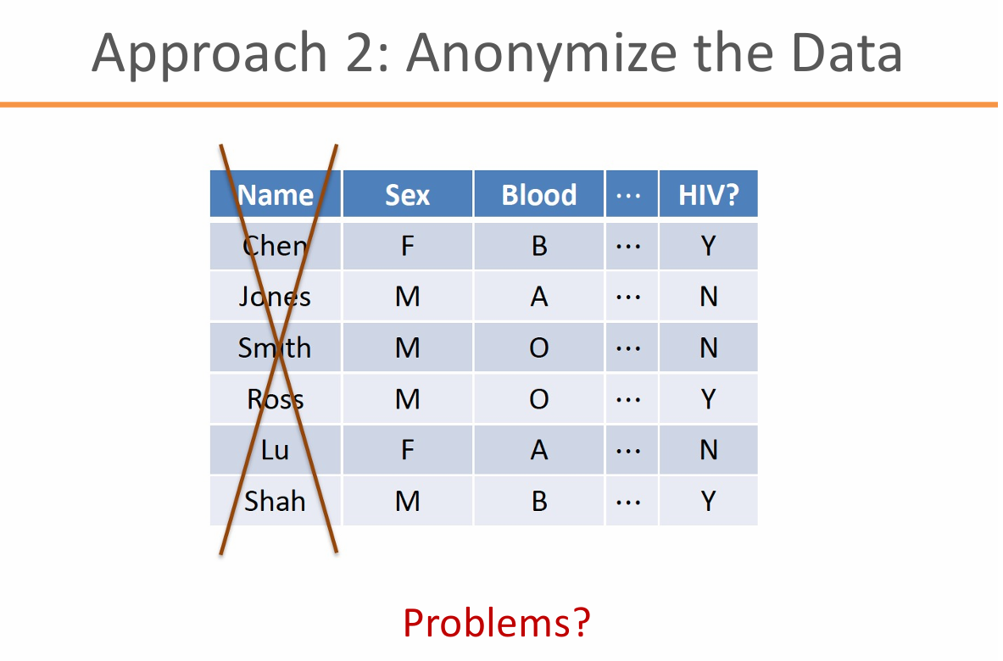

Slide 11
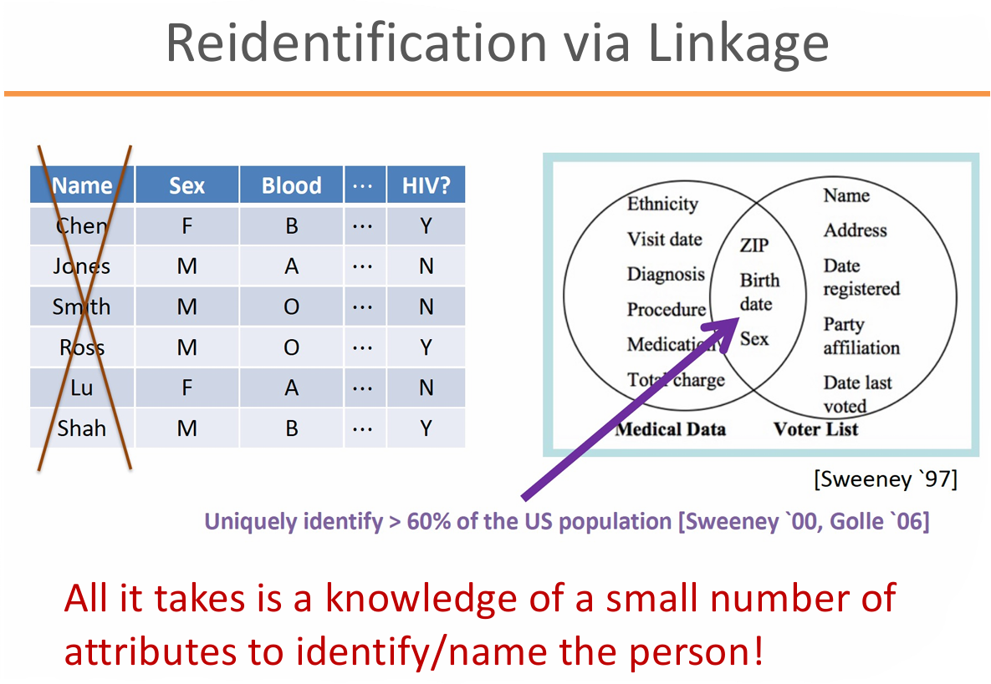

Slide 12
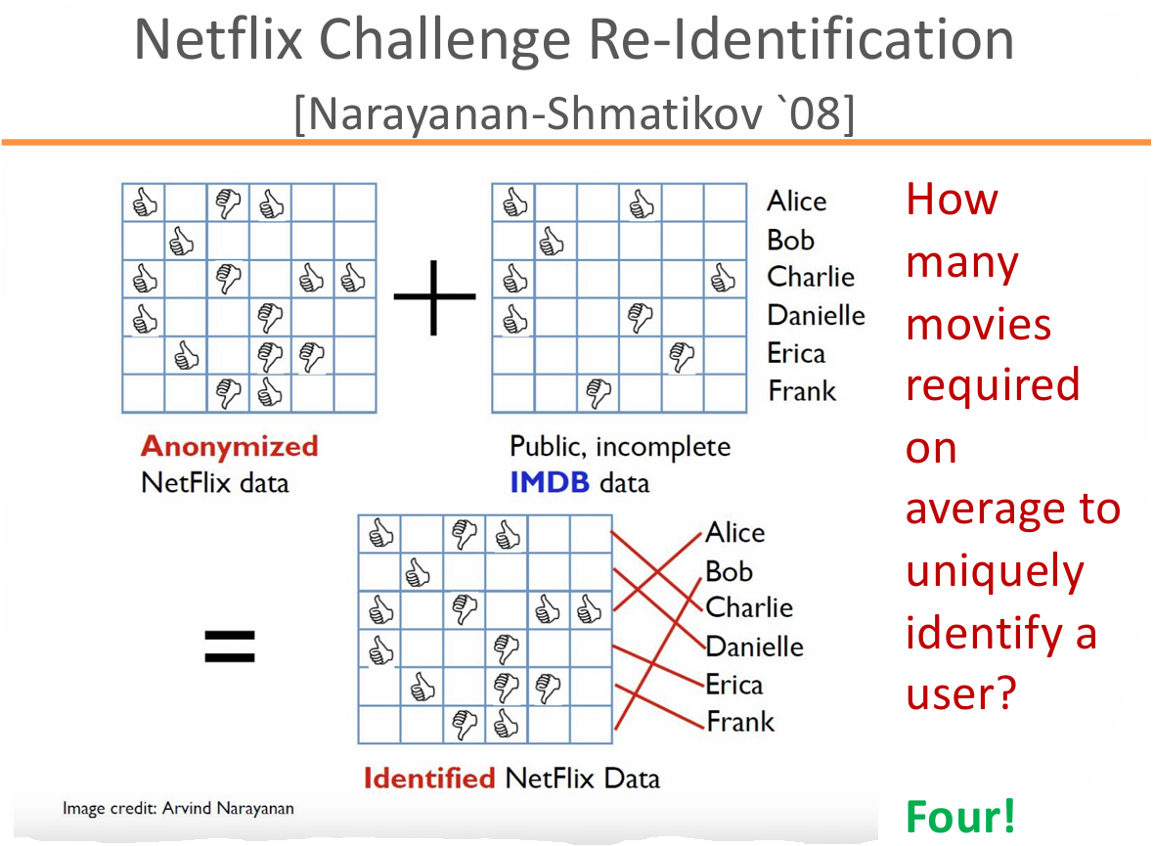

Slide 13
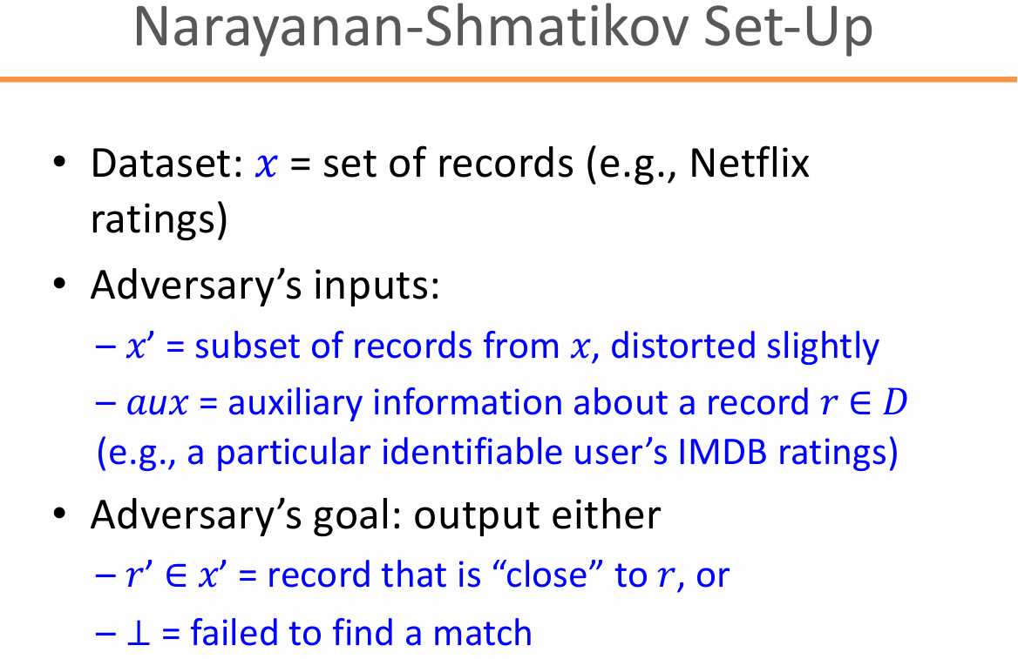

Slide 14
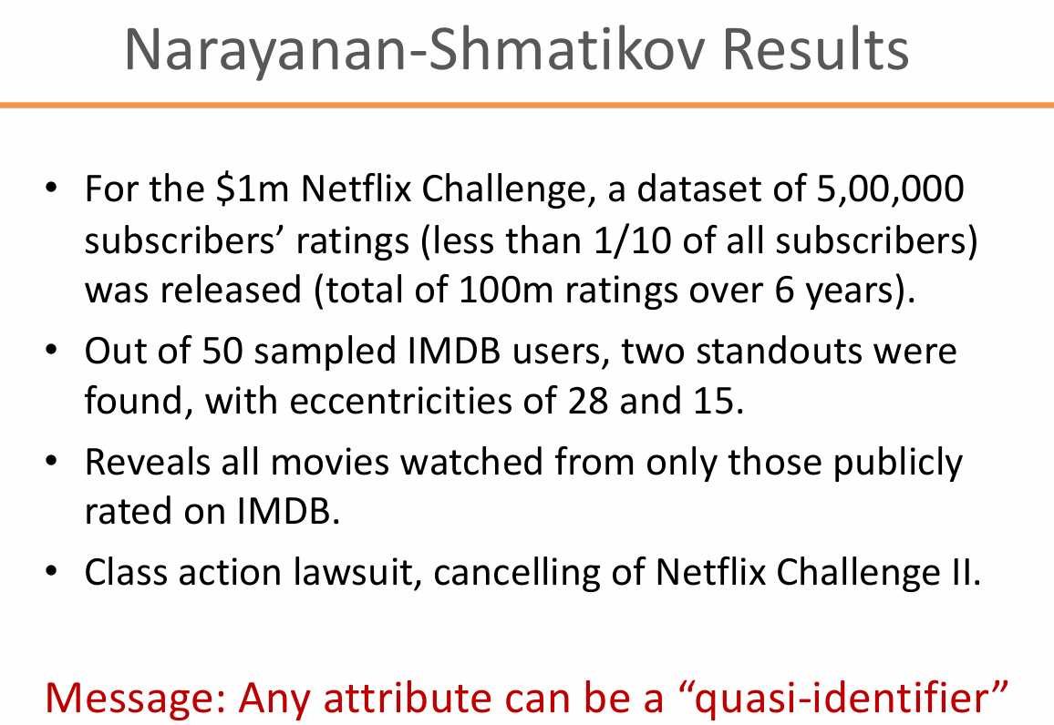
Notes:
Quasi-identifiers are pieces of information that are not of themselves unique identifiers, but are sufficiently well correlated with an entity that they can be combined with other quasi-identifiers to create a unique identifier. Quasi-identifiers can thus, when combined, become personally identifying information.

Slide 15
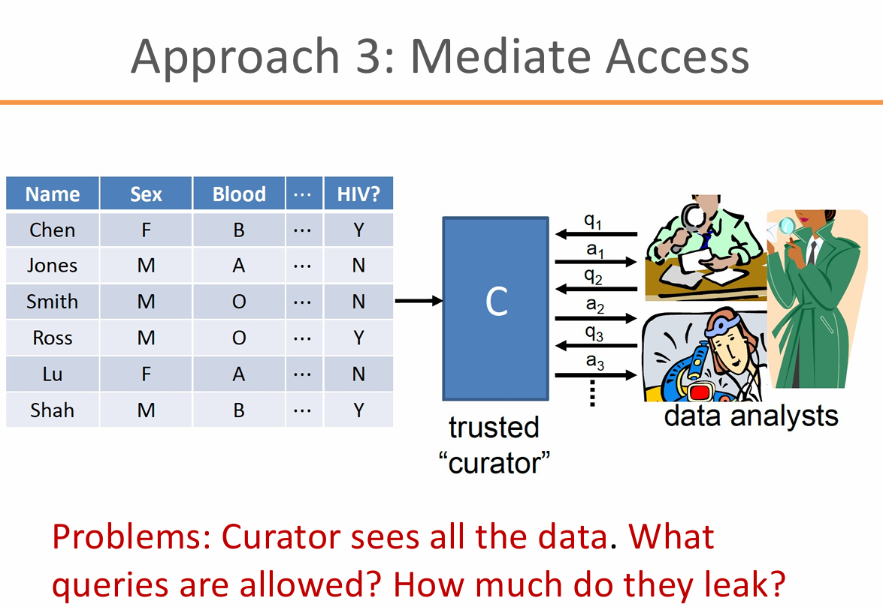

Slide 16
Why Is Anonymization Hard?

Slide 17
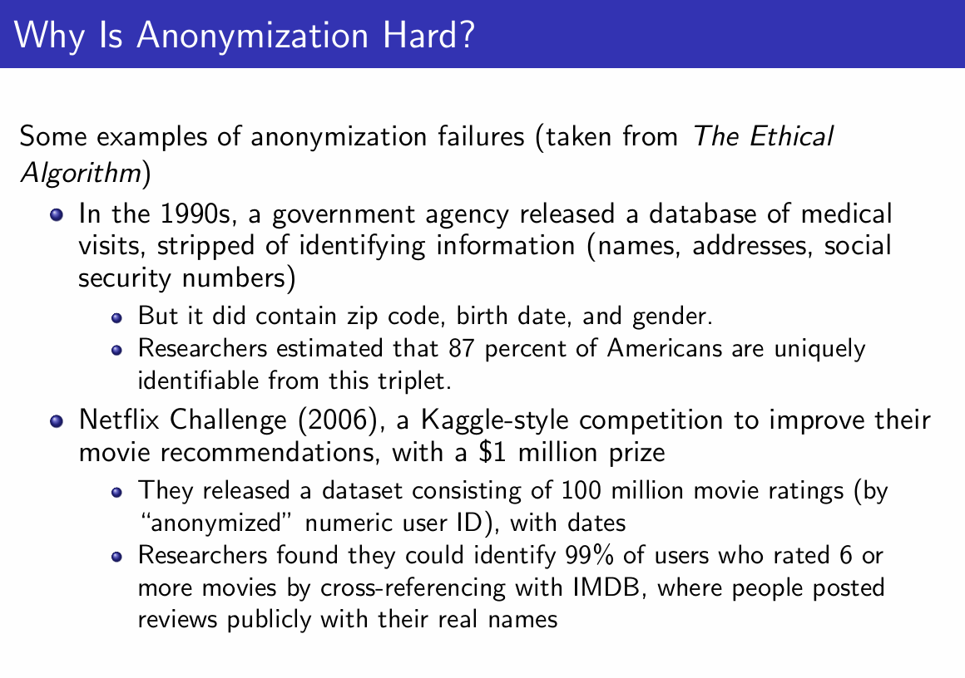
Anonymization Is Hard

Slide 18
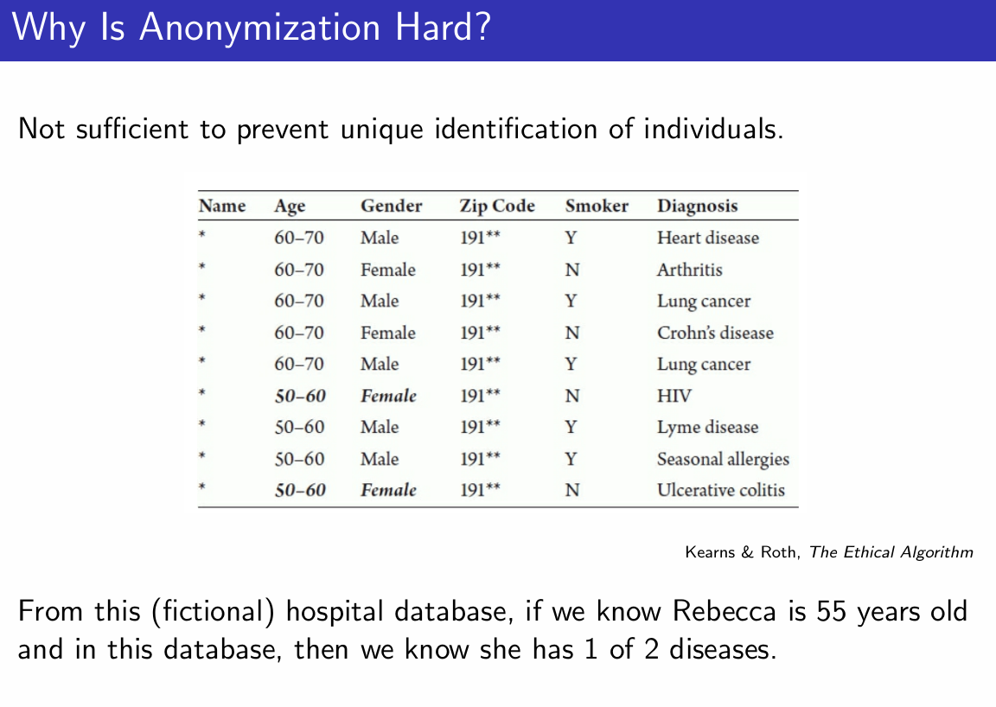
Anonymization Is Hard

Slide 19
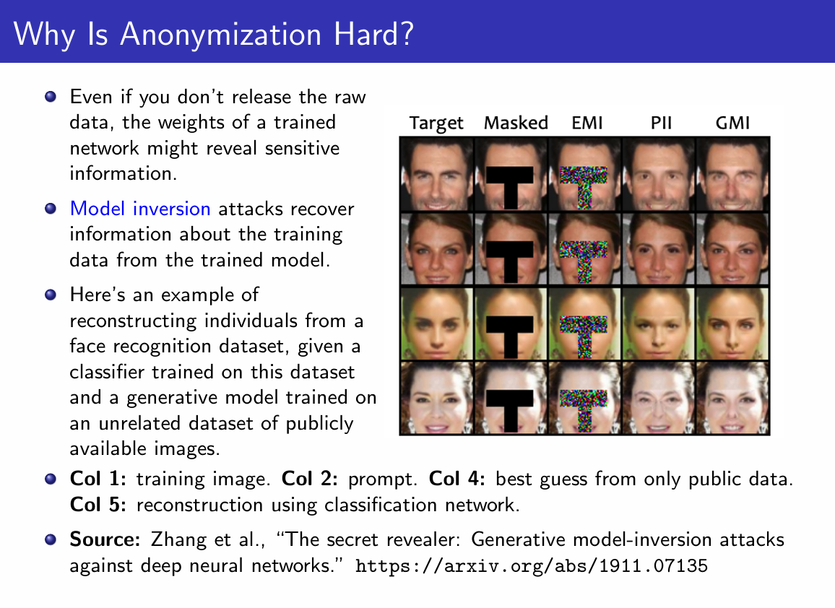
Anonymization Is Hard

Slide 20
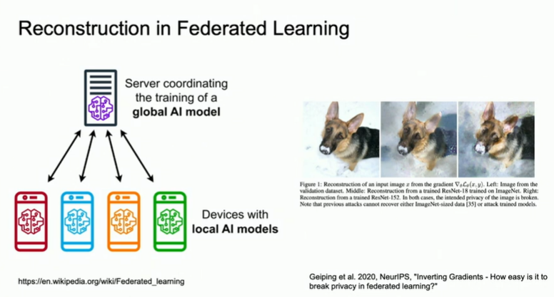
Anonymization Is Hard

Slide 21
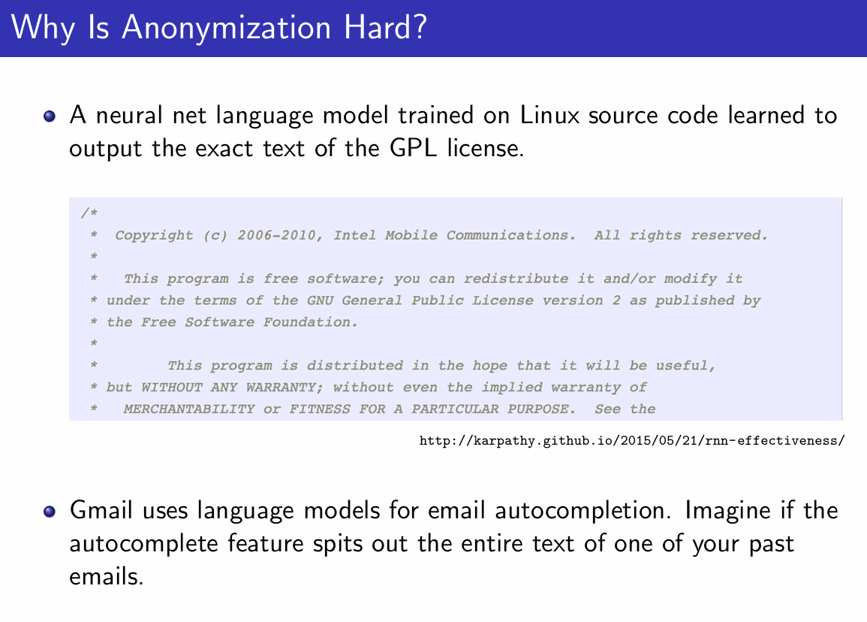
Anonymization Is Hard

Slide 22
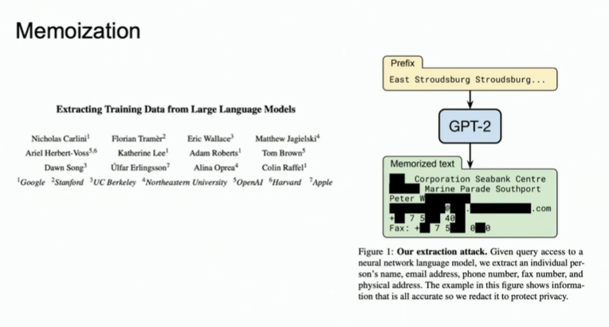
Anonymization Is Hard

Slide 23
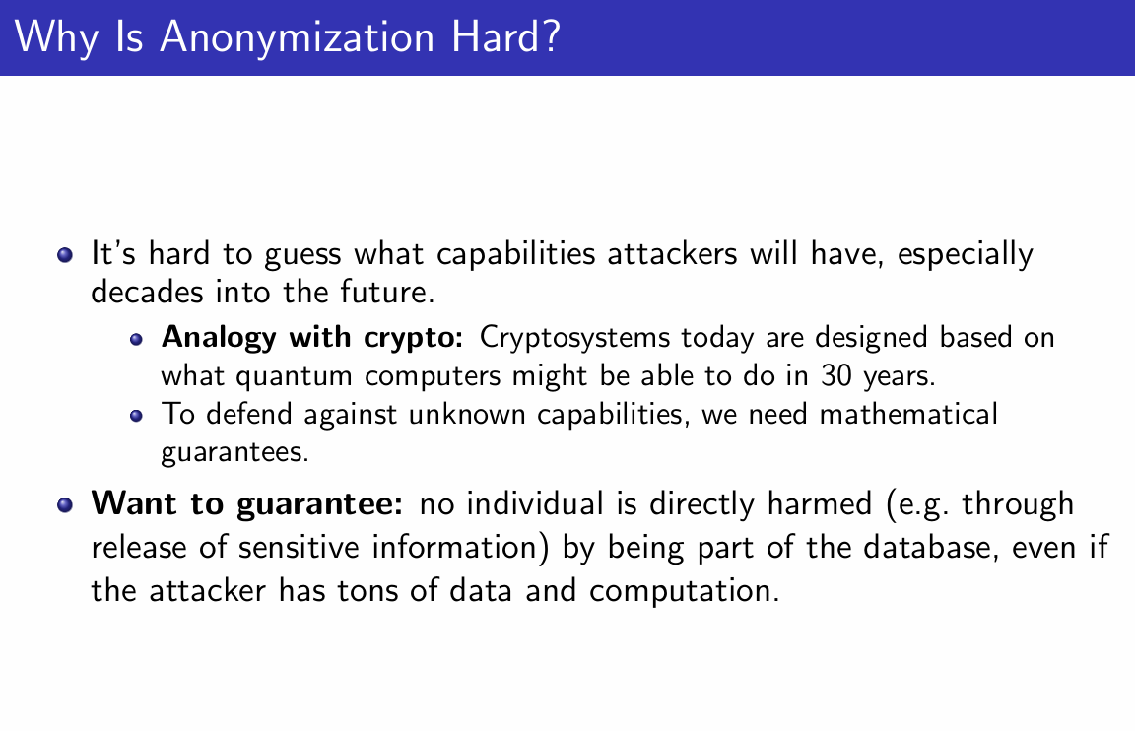
Anonymization Is Hard

Slide 24
Randomized Response

Slide 25
Randomized Response
Concept: A survey technique ensuring some level of privacy through randomization.
Example: Coin flip mechanism to provide truthful or random answers.
NB: Randomized response is not the same as differential privacy, but it serves as a foundational concept on which differential privacy is built.

Slide 26
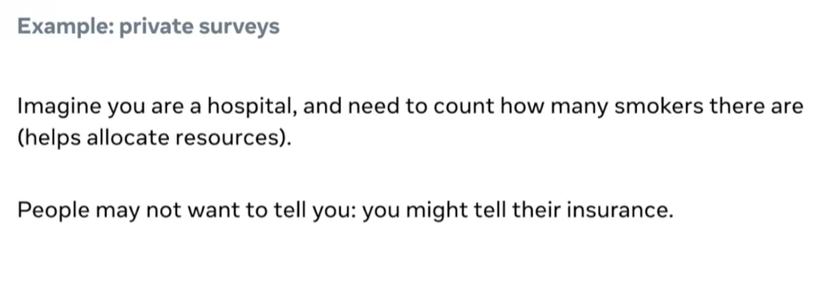
Randomized Response
Big Question: How do we still see the forest but somehow, lose some resolution on the trees?

Slide 27
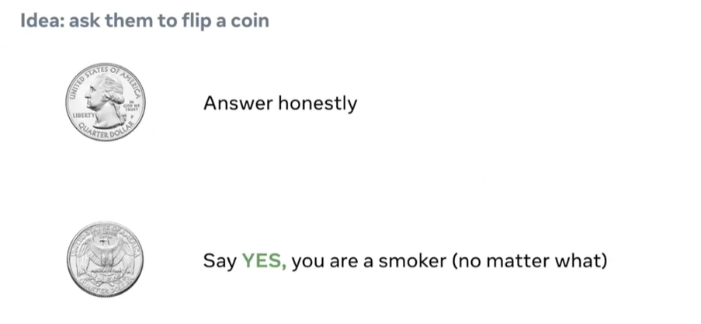

Slide 28
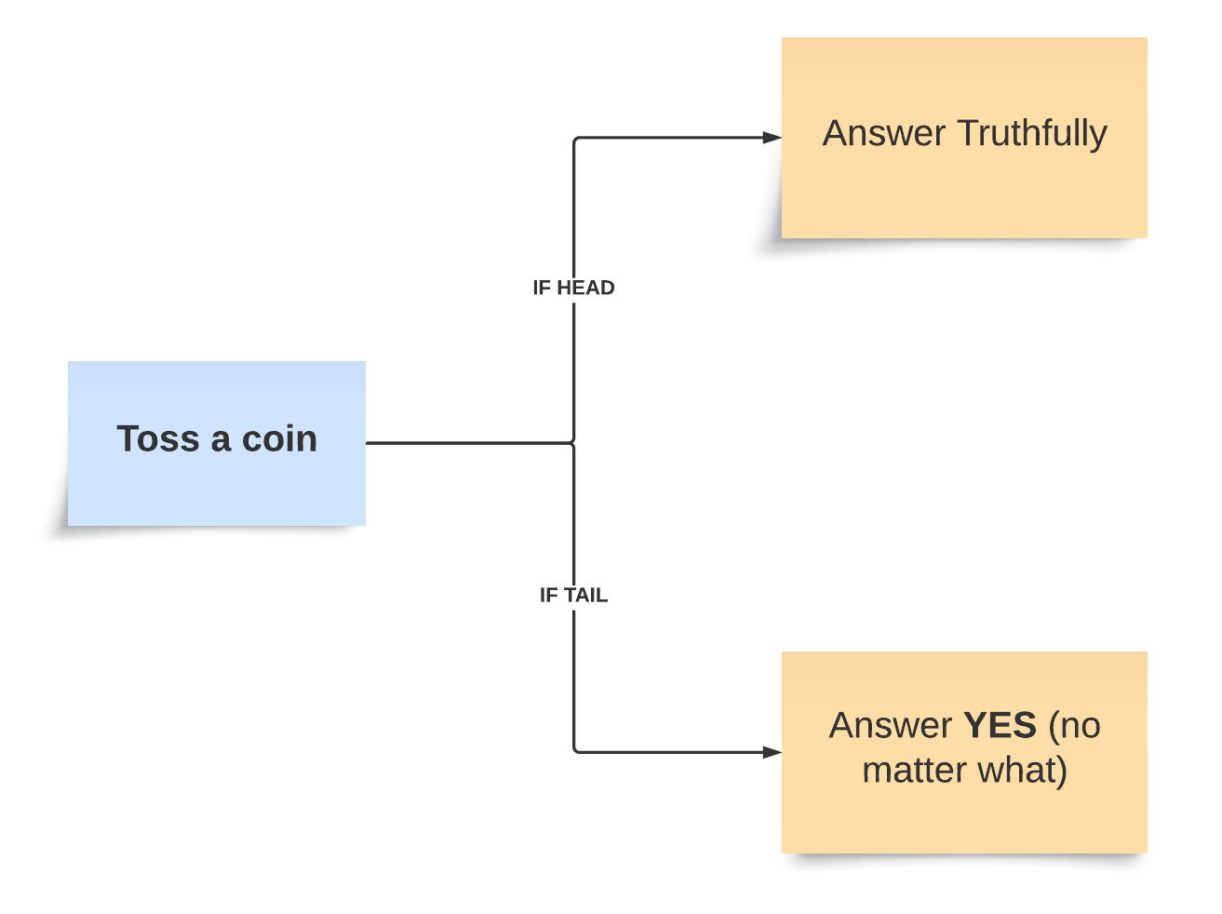
Question: Are you a smoker?

Slide 29
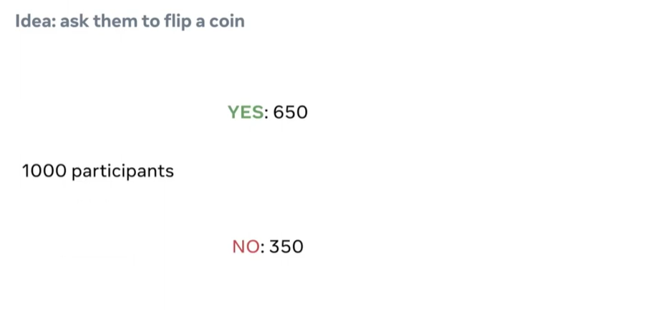

Slide 30
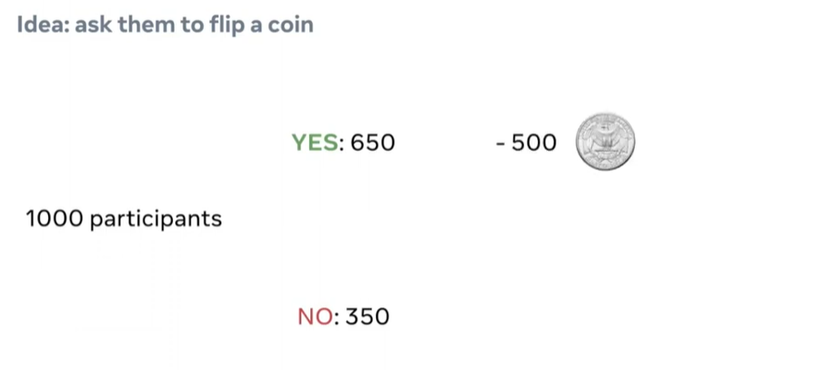
Randomized Response

Slide 31
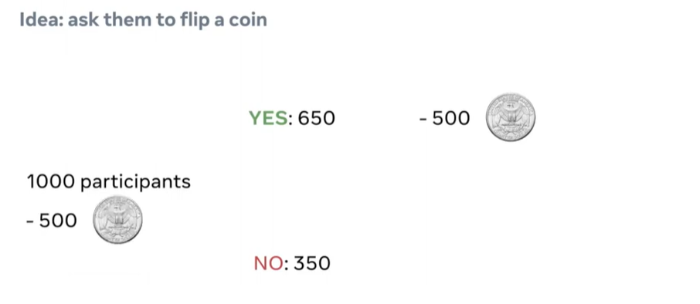
Randomized Response

Slide 32
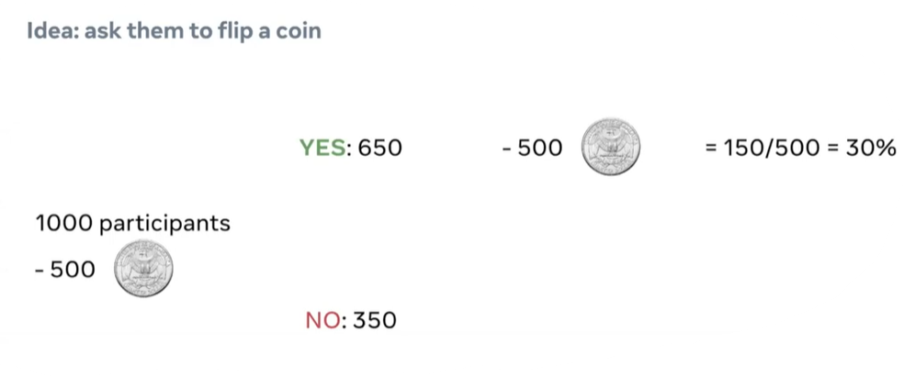
Randomized Response

Slide 33
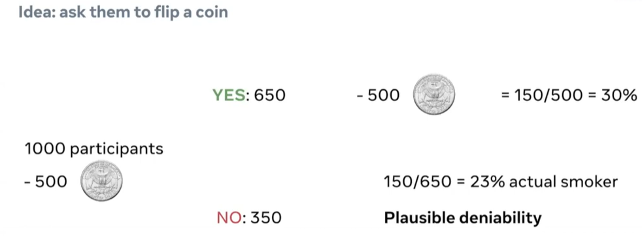
Randomized Response
Any person who answers "Yes" has plausible deniability.
This is because, even if the person is a smoker, they can credibly claim that their "Yes" response was due to the coin landing on tails, not because they were admitting to smoking. (NO TRACE, NO CASE)

Slide 34
What Is Differential Privacy?

Slide 35
Differential Privacy
Differential Privacy is a system for publicly sharing information about a dataset which obscures individual contributions while retaining the big picture, by adding controlled random noise.
▪ Doesn’t require attack modeling
▪ Privacy loss is quantifiable
▪ Compose multiple queries
▪ Accessible, minimal utility loss, easy to compute

Slide 36
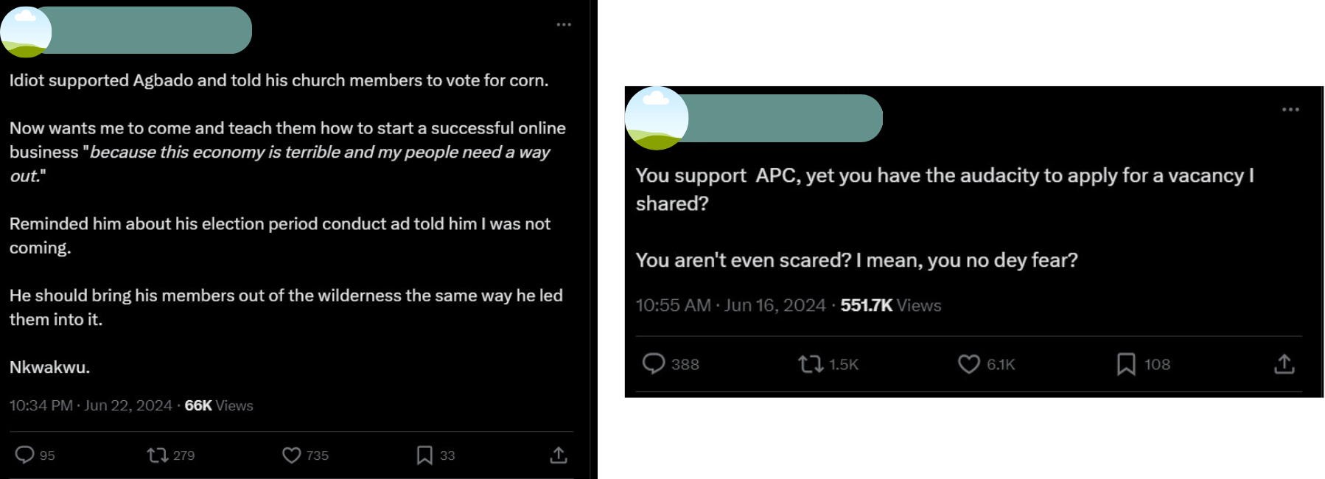
Imagine a scenario like this ….
By applying differential privacy, organizations can better manage sensitive data related to individuals’ privacy; example, political opinions and behaviors, as seen in the above tweets, ensuring that users' privacy is maintained while still benefiting from the collected data for broader analysis and insights.

Slide 37
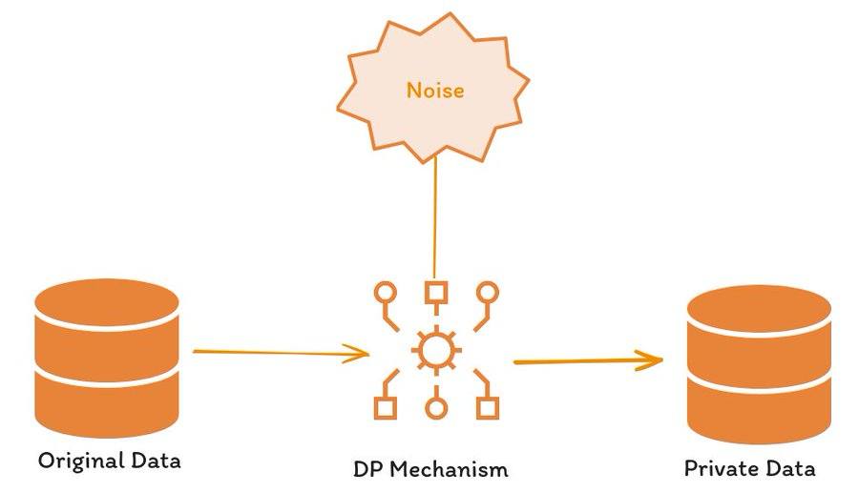

Slide 38
DP ensures that if you have two datasets that are almost identical, except for one record, the probability of getting the same outcome from an algorithm applied to each dataset remains nearly unchanged.
This means that even small changes in the data won't drastically affect the results.

Slide 39
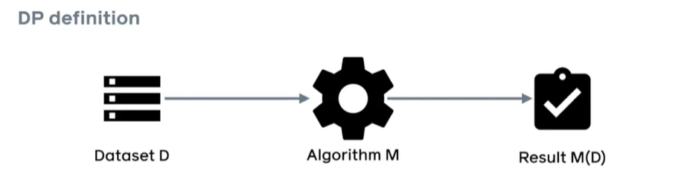

Slide 40
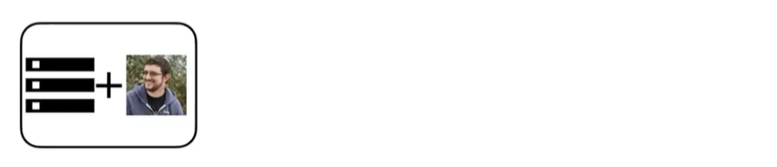


Slide 41
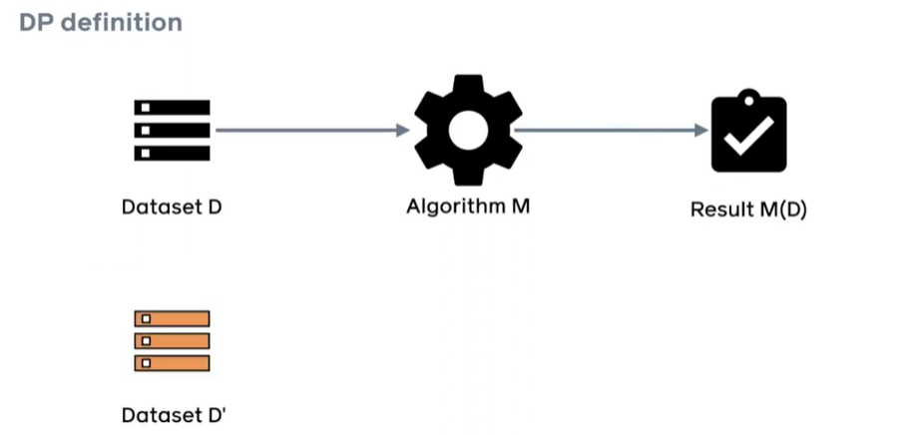

Slide 42
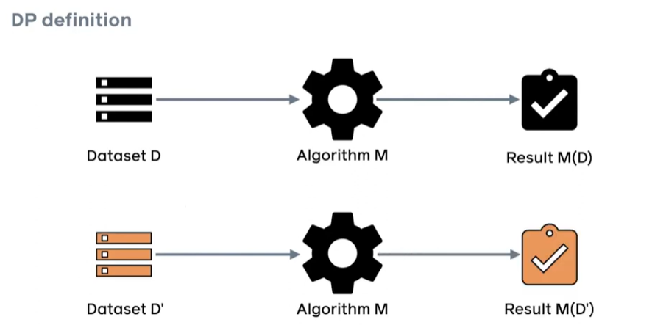

Slide 43
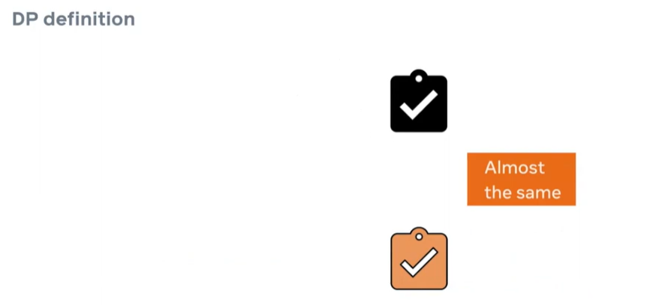

Slide 44
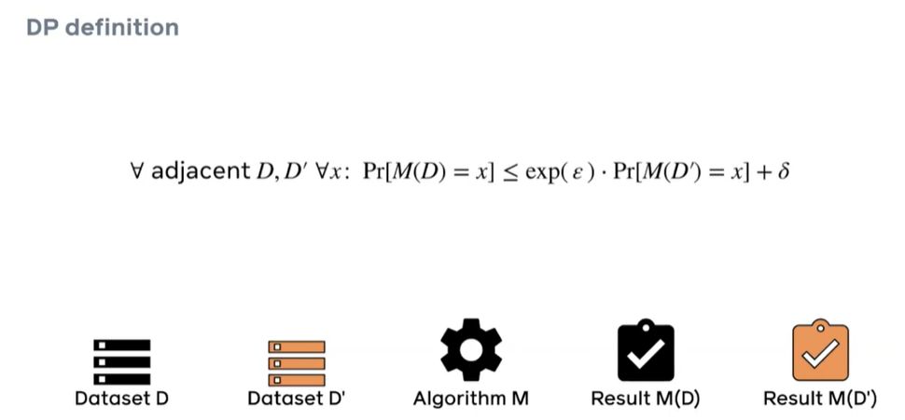

Slide 45
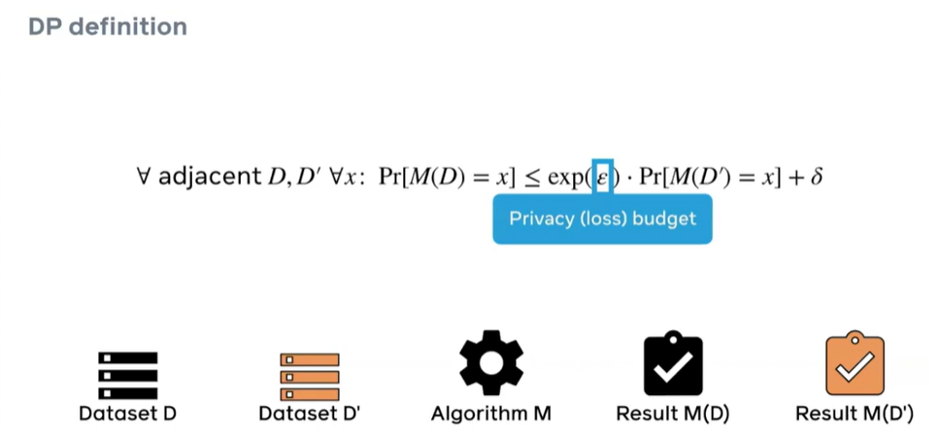
Epsilon (ϵ): is a parameter that measures the privacy guarantee.
- ϵ parameter quantifies the amount by which Result M(D) & Result M(D’) differs
A smaller ϵ = better privacy protection but more noise added to the data
A larger ϵ = less noise added to the data but weaker privacy protection.
Delta (δ): a parameter representing the probability of the privacy guarantee failing.

Slide 46
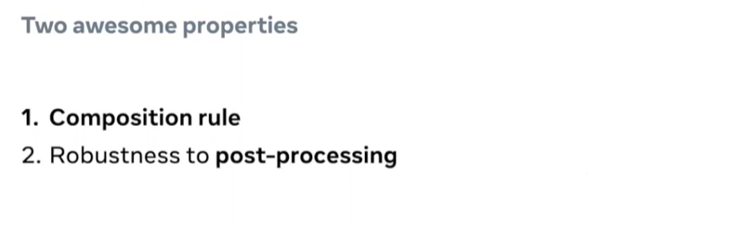
Properties of DP

Slide 47
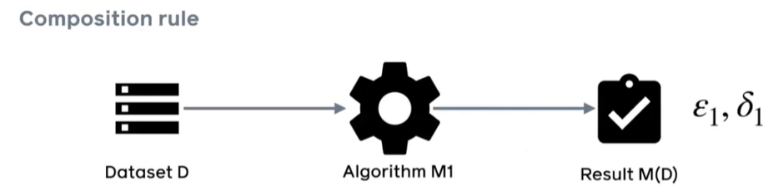
Properties of DP

Slide 48
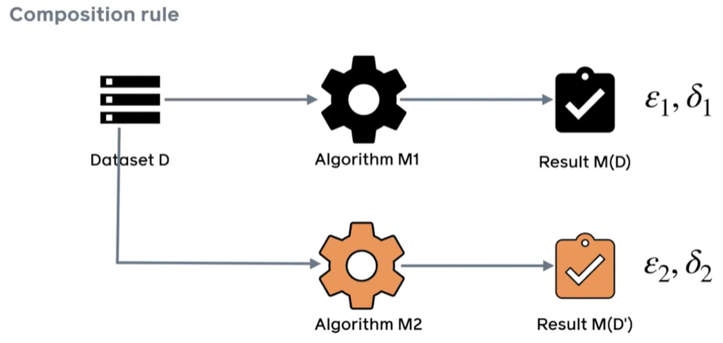

Slide 49
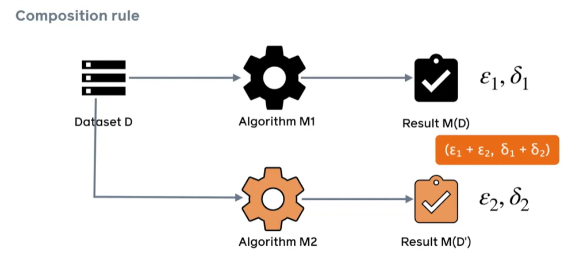

Slide 50
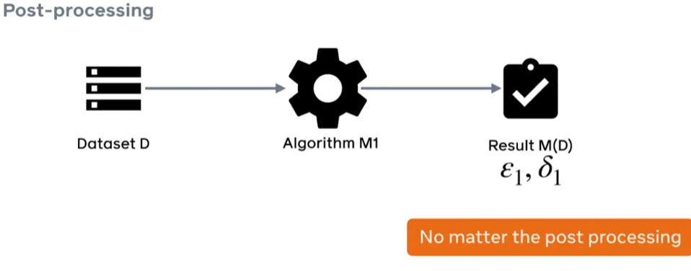

Slide 51
Differential Privacy in Machine Learning

Slide 52
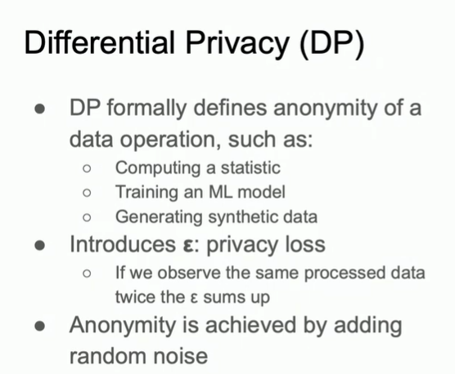
DP in Machine Learning

Slide 53
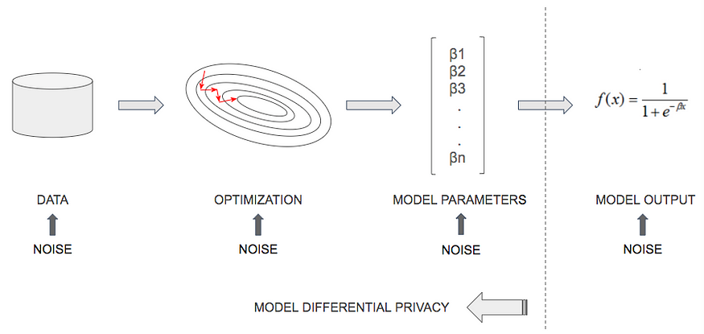
DP in Machine Learning
Noise Injection Methods
In the training data itself
During optimization
In the parameters output by the model,
At query time (each time the model is used)

Slide 54
The model in the last method is not differentially private, but the querying mechanism is: this means that each query to the model leaks some small amount of information about the original data. Therefore we can only use that type of model a limited amount of times before the privacy budget becomes too great, thus risking exposing individual records.

Slide 55
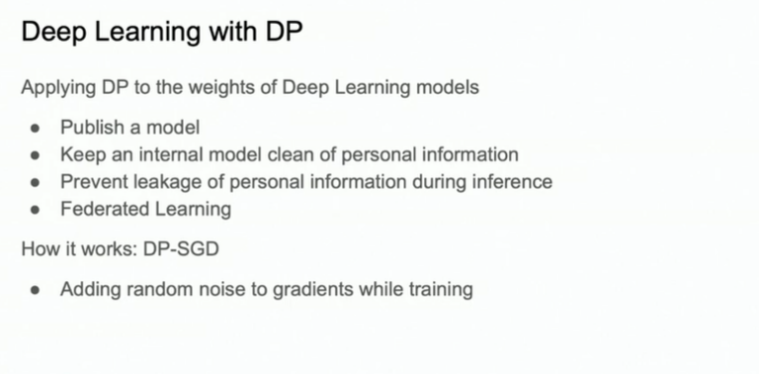
DP in Machine Learning

Slide 56
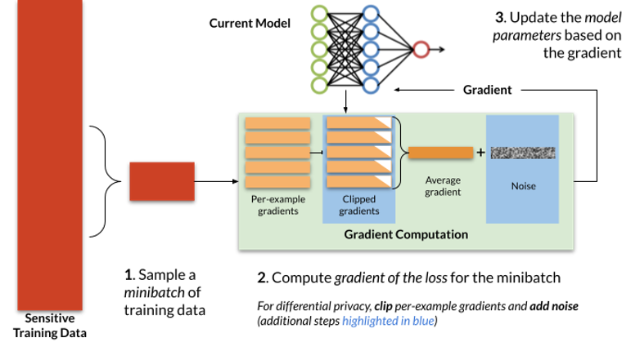
DP in Machine Learning

Slide 57

DP in Machine Learning
Frameworks To Implement Differential Privacy

Slide 58

Applications of Differential Privacy

Slide 59
Limitations of DP
1) Privacy-Utility Trade-off
Data Accuracy: Noise added to ensure privacy can degrade data accuracy and utility.
Balance: Achieving the right balance between privacy and utility can be challenging.
2) Computational Overhead
Performance: Adding noise introduces significant computational overhead, making algorithms slower and more resource-intensive.
Scalability: Computational cost can be a limiting factor for large datasets or real-time applications.
3) Parameter Selection
Epsilon (ε) Value: Controls the level of privacy. Small ε offers better privacy but worse utility, while large ε provides better utility but weaker privacy.
Lack of Guidelines: No universally accepted guidelines for selecting ε, requiring domain-specific considerations.

Slide 60
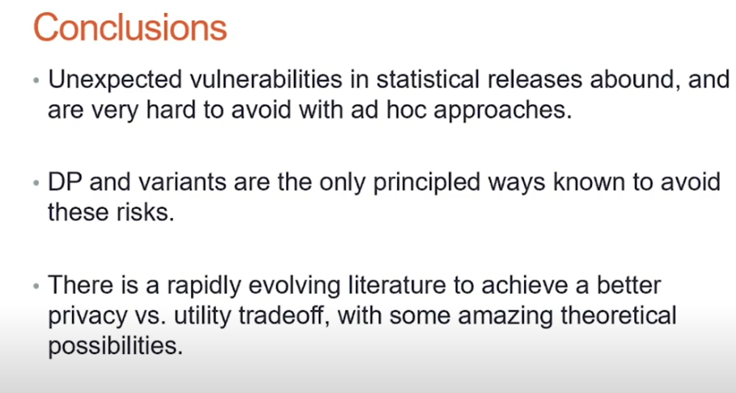
Conclusion

Slide 61

Demo Implementation

Slide 62
THANK YOU!

Slide 63
References
Cynthia Dwork and Aaron Roth's book on The Algorithmic Foundations of Differential Privacy: https://www.cis.upenn.edu/~aaroth/Papers/privacybook.pdf
Kritika’s Introduction to Differential Privacy: https://iiittheorygroup.github.io/Initiatives/Seminar-Saturdays/2021_spring/slides_019.pdf
University of Toronto CSC 2515 Lecture 11: Differential Privacy: https://www.cs.toronto.edu/~rgrosse/courses/csc2515_2019/slides/lec11-slides.pdf
Harvard CS208: Applied Privacy for Data Science. https://6s060.csail.mit.edu/2021/lec/diffpriv.pdf
Davide Testuggine’s Differentially Private Model Training with Opacus: https://www.youtube.com/watch?v=MWPwofiQMdE
Sophia Collet’s blog on Differential Privacy in the Real World: https://medium.com/bluecore-engineering/differential-privacy-in-the-real-world-f31a5df1398f

